Slide 1
Machine Learning with Golang
Ephraim Berkovitch, Jan 2021 / ZipRecruiter

Slide 2
Agenda
Why ML in Go? Use cases for programming ML/DL with Go; pros and cons
Go ML development environments
Supporting Libraries – gota (pandas), gonum (numpy), gonum/plot (matplotlib)
Algorithms - https://github.com/cdipaolo/goml (sklearn equivalent)
Supervised Learning
Unsupervised Learning
Using pre-trained models
Deploying ML applications

Slide 3
Accompanying Materials
https://github.com/ephraimberkovitch/golang_ml
http://www.cs.jhu.edu/~mdredze/datasets/sentiment/processed_acl.tar.gz

Slide 4
Why ML in Go
simple syntax
clearly describe complex algorithms
does not obscure developers from understand how to run efficient optimized code

Slide 5
Why ML in Go – in general
Easy to learn and on-board new developers
Fast build time
Good performance at run-time
Great concurrency support
Excellent standard library
Type safety
Easy-to-read, standardized code with gofmt
Forced error handling to minimize unforeseen exceptions
Explicit, clear dependency management
Easy to adapt architecture as projects grow

Slide 6
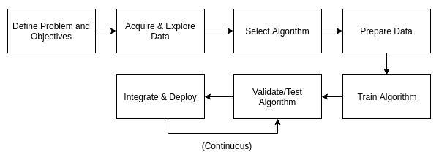
Why consider using ML in Go
General mature eco-system in Go
No dead code / no unused imports
Compiled code
gofmt

Slide 7
Jupyter Kernel for Go
gophernotes
https://github.com/gopherdata/gophernotes - backend - interpreter
alternatives - lgo (https://github.com/yunabe/lgo) - backend - official compiler, elder versions
docker run -it -p 8888:8888 -v $(pwd):/usr/share/notebooks gopherdata/gophernotes:latest-ds

Slide 8
Data Wrangling Library - gota
Counterpart of Python’s pandas
https://github.com/go-gota/gota
Load CSV
Pre-processing data
Re-name, remove columns
Filter out irrelevant data
Training / validation data
Dataframe.Subset
Encoding data with categorical values

Slide 9
Scientific and Plotting Library - gonum + gonum/plot
Counterpart of Python’s numpy
https://www.gonum.org/ - GoNum
set of packages designed to make writing numerical and scientific algorithms productive, performant, and scalable

Slide 10
Supervised Algorithms
Classification
Regression

Slide 11
Unsupervised Algorithms
Clustering
PCA

Slide 12
Using pre-trained modules
TensorFlow for Go is not mature yet
https://www.tensorflow.org/install/lang_go - The TensorFlow Go API is not covered by the TensorFlow API stability guarantees
There is a Gorgonia framework, written completely in Go - low-level, like Theano, but has higher goals like Tensorflow

Slide 13
Using Python models
When to adopt a polyglot approach
Polyglot – use Python-only libraries like Keras in Python, reduce amount of code and in some cases, better performance, multi-team cooperation, leverage pre-existing models; more complex problems, deep learning, computer vision
Go-only - easier to maintain, less dependencies, less complexities in component interactions; when existing Go libraries offer what you need

Slide 14
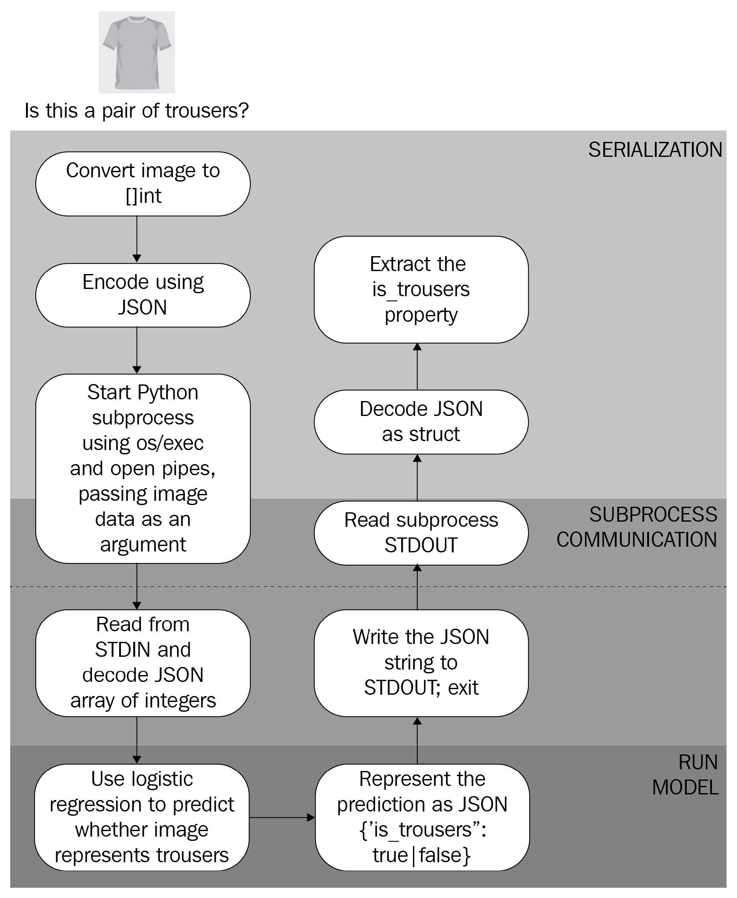
Invoke Python model using os/exec
Model is on the same machine
use command-line arguments to pass inputs to the model and read the model's prediction from standard output (STDOUT)
JSON for data exchange
Load dataset to dataframe
stdout, err := cmd.StdoutPipe()
b, err = InvokeAndWait("model.py", "predict", string(b))
Cons – start a new Python process to handle every
request, coupling with Python
Pros – small effort

Slide 15
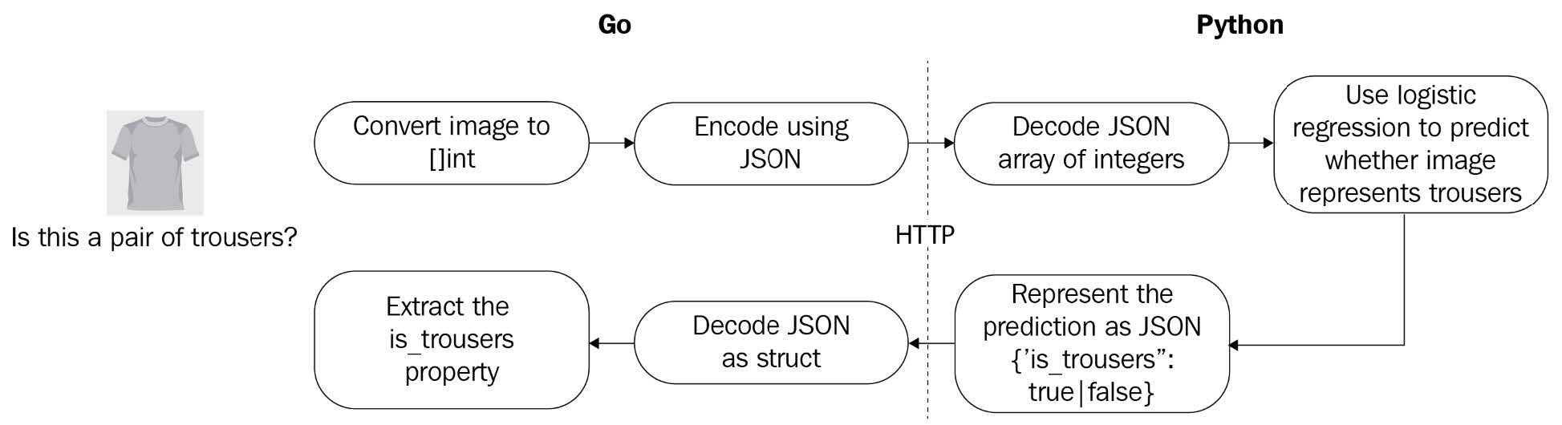
Invoke Python models using HTTP
Model is running as a service on different machine

Slide 16
Go bindings of TensorFlow
Install TensorFlow as a docker
Import pre-trained TensorFlow model
savedModel, err := tf.LoadSavedModel("./saved_model", []string{"serve"}, nil)
if err != nil {
log.Fatalf("failed to load model: %v", err)
}

Slide 17
Deployment

Slide 18
When and where to use ML
Typical stages in ML project

Slide 19
Pure Go ML frameworks
Gorgonia – DL
Prose - NLP

Slide 20
References
Michael Bironneau, Toby Coleman, Machine Learning with Go Quick Start Guide, Packt Publishing, 2019
Xuanyi Chew, Go Machine Learning Projects, Packtpub, 2018 (https://github.com/PacktPublishing/Go-Machine-Learning-Projects)
https://tech.travelaudience.com/training-tensorflow-models-in-python-and-serving-with-go-1b2a9386b0ff
https://towardsdatascience.com/why-we-deploy-machine-learning-models-with-go-not-python-a4e35ec16deb
https://github.com/gorgonia/gorgonia
https://github.com/jdkato/prose

